Slide 1

Helmet Detection using Machine Learning and Automatic License Plate Recognition
Presented By:
R.Harshitha 22R01A67H6
Shaik Sharif 22R01A67J3
V.Pranayvarshan 22R01A67J5
V.Arun Kumar 22R01A67J6

Slide 2
1. Introduction 2. Objective of the project 3. System Analysis 4. System design 5. testing 6. screenshots 7. conclusion
LIST OF CONTENTS

Slide 3
INTRODUCTION
This project aims to improve road safety by automatically detecting motorcyclists who are not wearing helmets using machine learning. It also uses automatic license plate recognition (ALPR) to identify the violators' vehicles. By combining helmet detection with license plate recognition, the system enables efficient and real-time traffic rule enforcement.

Slide 4
Motorcycle accidents have been rapidly growing through the years in many countries. In India more than 37 million people use two wheelers. Therefore, it is necessary to develop a system for automatic detection of helmet wearing for road safety. Therefore, a custom object detection model is created using a machine learning based algorithm which can detect motorcycle riders. On the detection of a helmetless rider, the license plate is extracted and the license plate number is recognized using an optical character recognizer. This application can be implemented in real-time using a dataset as input.
OBJECTIVE OF THE PROJECT

Slide 5
SYSYTEM ANALYSIS
EXISTING SYSTEM:
Existing system monitors the traffic violations primarily through CCTV recordings, where the traffic police have to look into the frame where the traffic violation is happening, zoom into the license plate in case rider is not wearing helmet.
But this requires lot of manpower and time as the traffic violations frequently and the number of people using motorcycles is increasing day-by-day.
What if there is a system, which would automatically look for traffic violation of not wearing helmet while riding motorcycle/moped and if so, would automatically extract the vehicles’ license plate number.
The License plate extraction code extracts only from the motor bikes which has a rider who is not wearing helmet and discards the License plate of the motor bikes whose rider has helmet
The OCR model is able to detect and recognize the License plates present in an image with an accuracy up to 85 percent.

Slide 6
PROPOSED SYSTEM:
In This, we a system to detect moving objects using a KNN classifier over the motorcyclist’s head to classify helmet.
These models were proposed based on statistical information of images and had a limitation to the level of accuracy that could be achieved
With the evolution of neural networks and deep learning models there was further improvement in the accuracy of classification.
Introduced a convolutional neural network (CNN) based method for object classification and detection
Use a CNN for classification of helmeted and non-helmeted riders.
Hence a DNN based model You Only Look Once (YOLO) was chosen. YOLO is a state-of-the-art, real-time object detection system

Slide 7
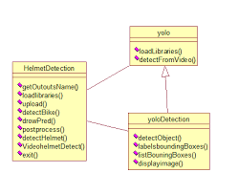
SYSTEM DESIGN
UML DIAGRAMS:
CLASS DIAGRAM:
The class diagram is the main building block of object oriented modeling.
Class diagrams can be used for data modeling.
In the diagram, classes are represented with boxes which contain three parts:
yolo
HelmetDetection
yoloDetection

Slide 8
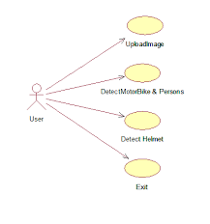
USECASE DIAGRAM:
A use case diagram at its simplest is a representation of a user's interaction with the system and depicting the specifications of a use case.
A use case diagram can portray the different types of users of a system and the various ways that they interact with the system.
This type of diagram is typically used in conjunction with the textual use case and will often be accompanied by other types of diagrams as well.

Slide 9
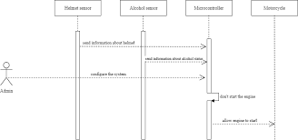
A sequence diagram is a kind of interaction diagram that shows how processes operate with one another and in what order.
SEQUENCE DIAGRAM:
A sequence diagram shows object interactions arranged in time sequence.
Sequence diagrams are typically associated with use case realizations in the Logical View of the system under development.

Slide 10
TESTING
Testing is the process where the test data is prepared and is used for testing the modules individually and later the validation given for the fields.
Then the system testing takes place which makes sure that all components of the system property functions as a unit.
The following is the description of the testing strategies, which were carried out during the testing period:
System Testing
Module Testing
Integration Testing
Acceptance Testing

Slide 11
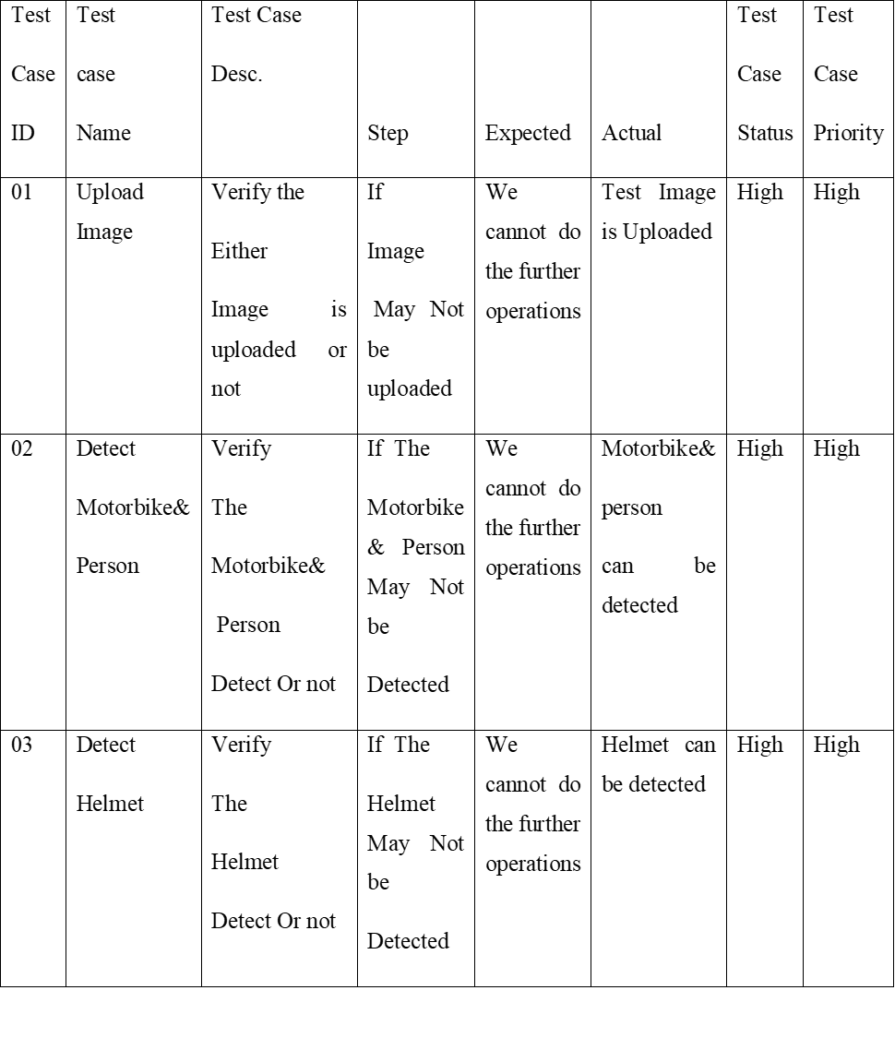

Slide 12
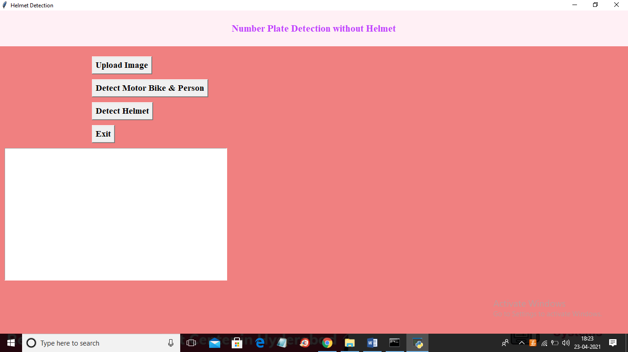
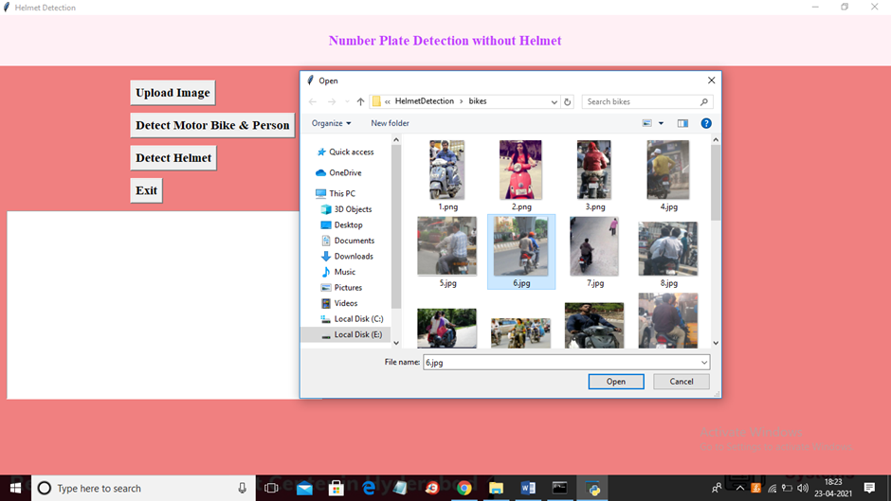
SCREENSHOTS

Slide 13
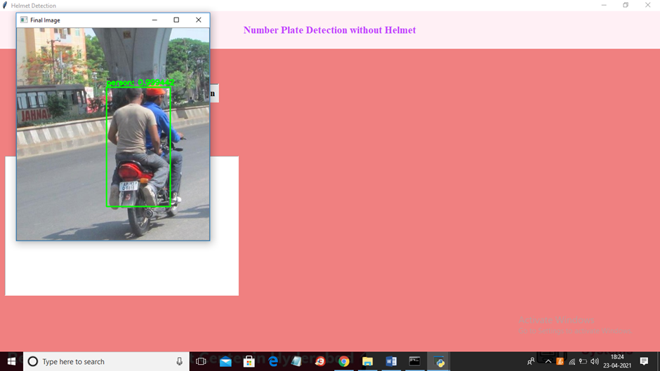
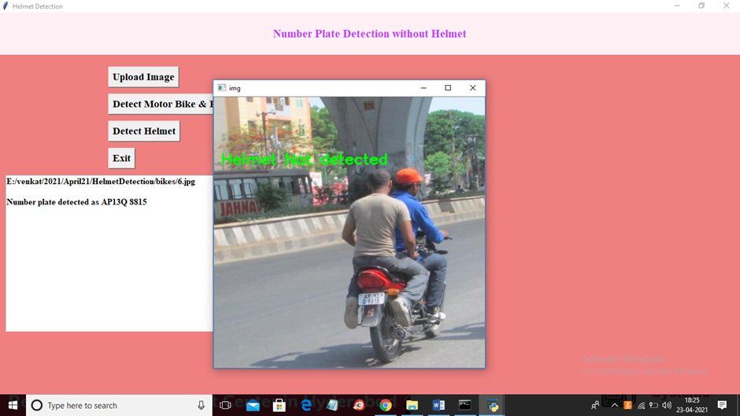

Slide 14
From the results shown above it is evident that the YOLO object detection is well suited for real-time processing and was able to accurately classify and localize all the object classes. The proposed end-to-end model was developed successfully and has all the capabilities to be automated and deployed for monitoring. For extracting the number plates some techniques are employed by considering different cases such as multiple riders without helmets and designed to handle most of the cases. All the libraries and software used in our project are open source and hence is very flexible and cost efficient. The project was mainly built to solve the problem of non-efficient traffic management. Hence at the end of it we can say that if deployed by any traffic management departments, it would make their job easier and more efficient.
CONCLUSION

